Slide 1
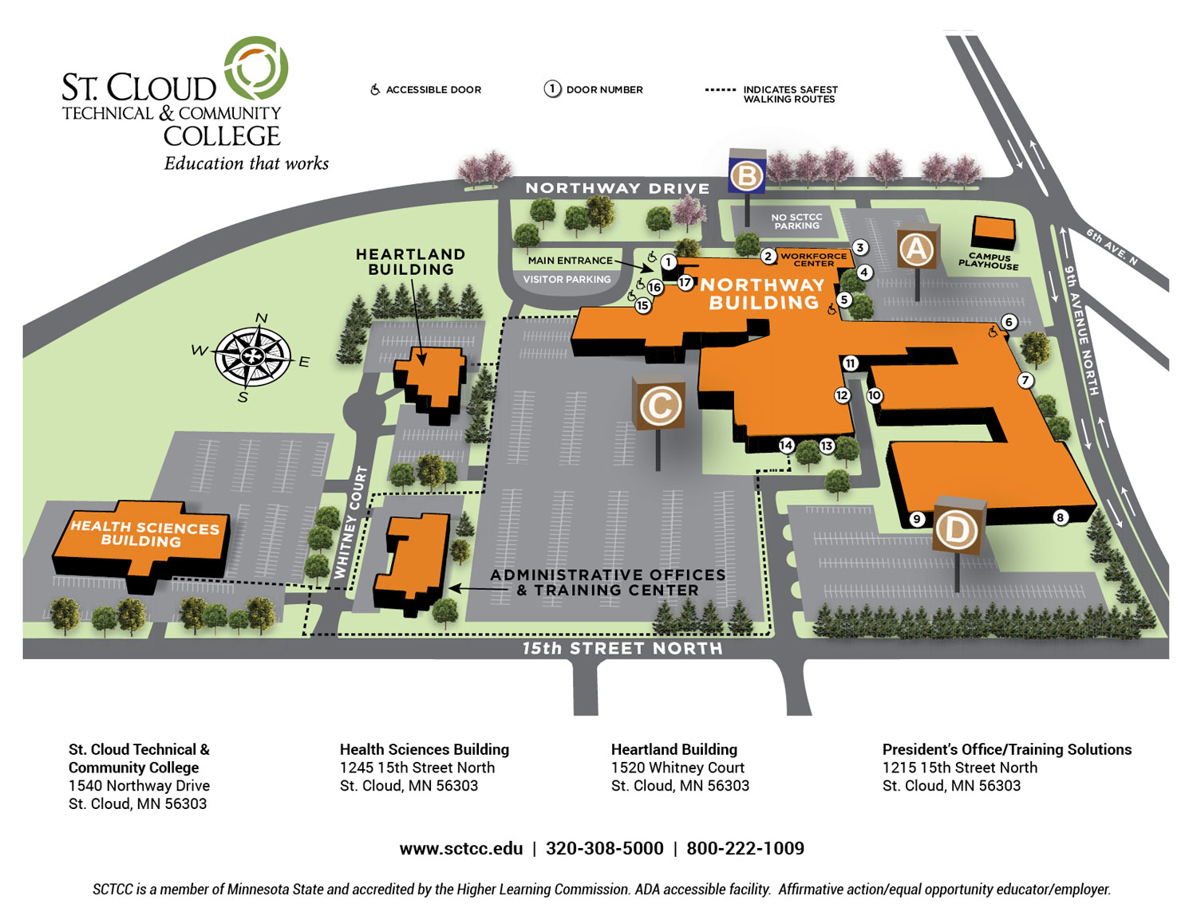
Safe House #3
of the I.M.P.R.E.S.S.
Address: 1540 Northway Dr, Saint Cloud, MN 56303
Type: GR

Slide 2
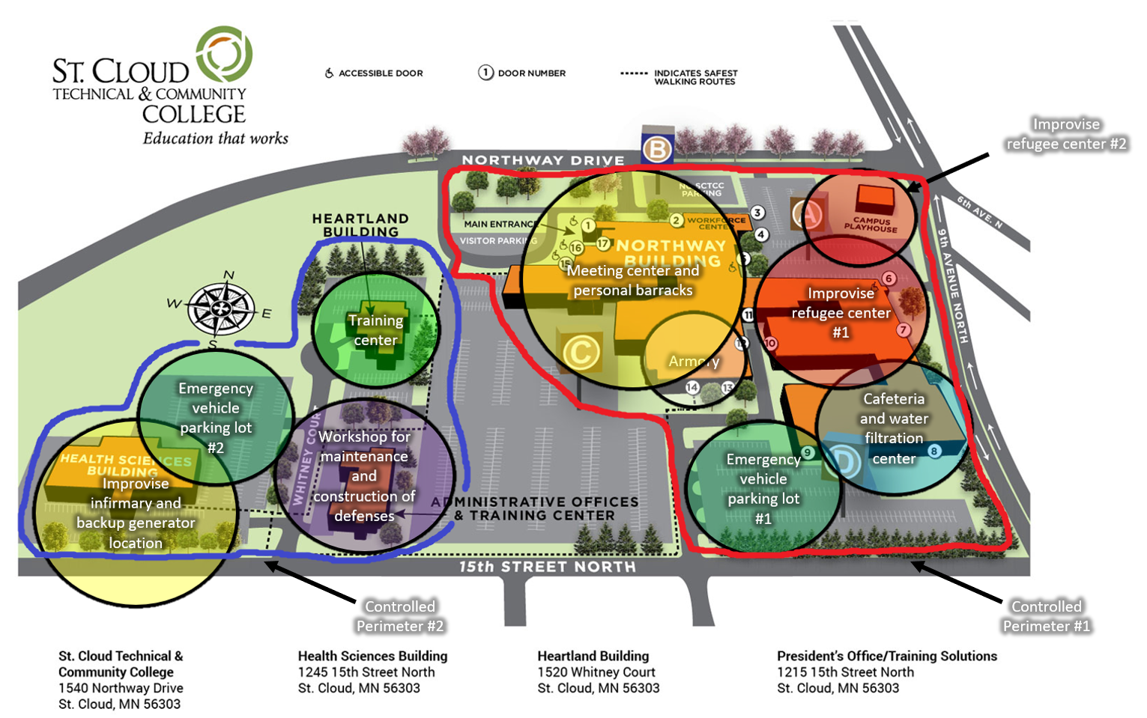
Safe House #3
of the I.M.P.R.E.S.S.
Address: 1540 Northway Dr, Saint Cloud, MN 56303
Type: GR
Zone 3-5
Zone 3-7
Pros:
*Safe Area.
*Easily defendable.
*Good installations.
Cons:
*Area lacks resources.
*Too many refugees need relocation.
Zone 3-7
Zone 3-4
Zone 3-6
Zone 3-2
Zone 3-9
Zone 3-3
Zone 3-8
Zone 3-1

Slide 3

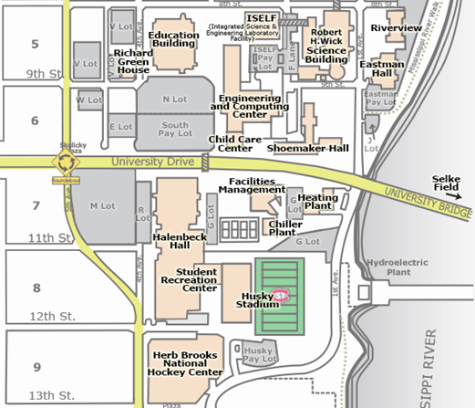

Slide 4
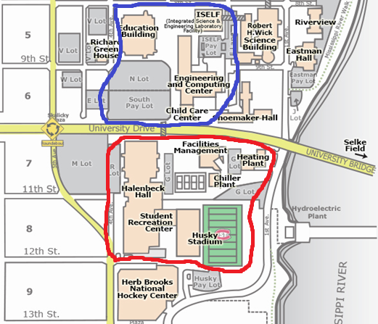
Improvise infirmary
Zone 4-1
Safe House #4
of the I.M.P.R.E.S.S.
Address: 720 4th Ave S, St Cloud, MN 56301
Type: GR
Workshop for maintenance and construction of defenses
Emergency vehicle parking lot
Zone 4-3
Zone 4-2
Controlled Perimeter #2
Pros:
*Safe Area.
*Easily defendable.
*Good installations.
*Area reach on resources.
*Airdrops are easily secure.
*Engineering personal above average.
Cons:
*Lacks enough weapons.
*Too many refugees need relocation.
*Unexperienced fighters.
Water filtration center and backup generator
Zone 4-9
Improvise refugee center
Zone 4-7
Training center
Meeting center and personnel barracks
Armory
Zone 4-4
Zone 4-6
Zone 4-5
Controlled Perimeter #1

Slide 5
Safe House #1
of the I.M.P.R.E.S.S.
Type: CR

Slide 6
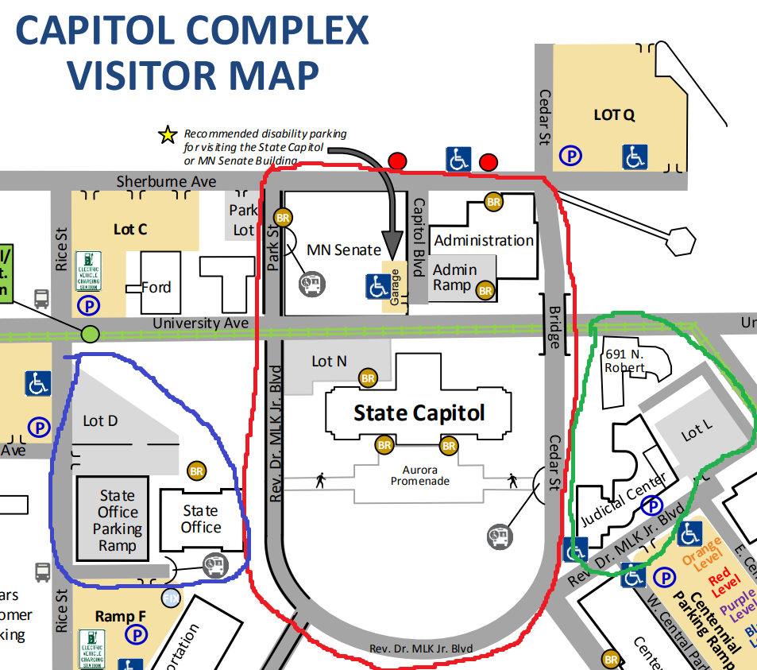
Safe House #1
of the I.M.P.R.E.S.S.
Address: 75 Rev Dr Martin Luther King Jr Blvd, Saint Paul, MN 55155
Type: CR
Improvise infirmary
Office for registration of refugees
Pros:
*Good installations.
*Area reach on resources.
*Superior room capacity.
*Superior infirmary.
*Medical personal above average.
*Fighter personal above average.
*Able to withstand explosives.
Cons:
*Many hostiles in the area.
*High value target.
Controlled Perimeter #1
Zone 1-1
Controlled Perimeter #3
Zone 1-0
Meeting center and personnel barracks #1
Zone 1-5
Improvise refugee center #1
Improvise refugee center #2
Zone 3-7
Water filtration center and backup generator
Zone 1-7
Zone 3-9
Controlled Perimeter #2
Meeting center and personnel barracks #2
Improvise refugee center #3
Improvise refugee center #4
Zone 1-5
Zone 1-7
Emergency vehicle parking lot
Zone 1-8
Zone 1-7

Slide 7
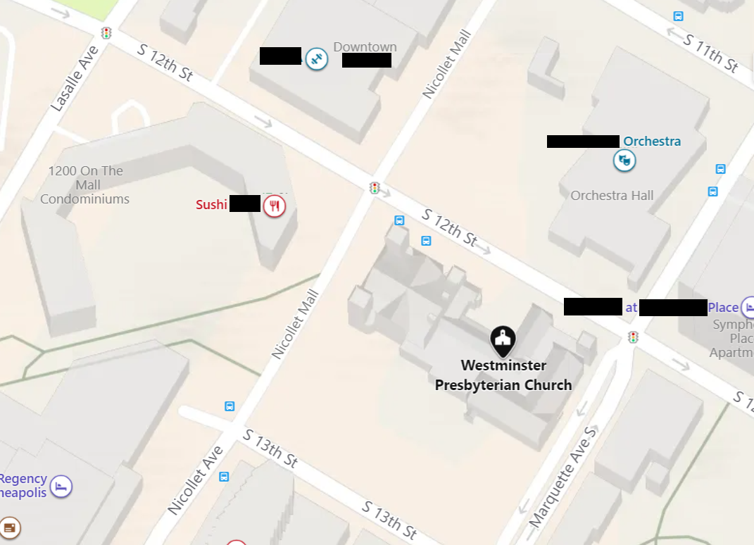
Westminster Presbyterian Church
Gym
Gym
Bar
Safe House #5
of the I.M.P.R.E.S.S.
Type: CR
Hotel
Place

Slide 8
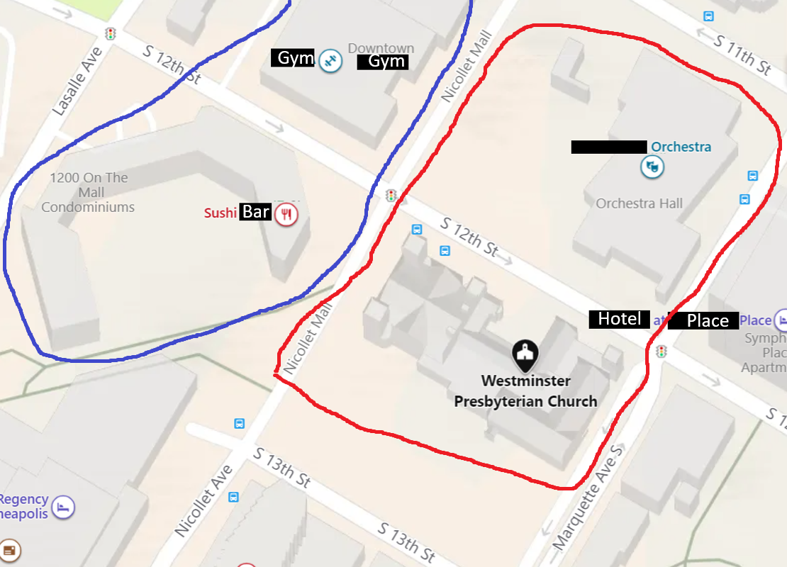
Westminster Presbyterian Church
Training center
Workshop for maintenance and construction of defenses
Zone 5-4
Zone 5-3
Armory
Zone 5-6
Cafeteria
Zone 5-9
Meeting center and personnel barracks
Water filtration and backup generator
Safe House #5
of the I.M.P.R.E.S.S.
Address: 1200 Marquette Ave S, Minneapolis, MN 55403
Type: GR
Zone 5-9
Emergency vehicle parking lot
Improvise refugee center
Zone 5-2
Zone 5-7
Zone 5-5
Improvise infirmary
Pros:
*Superior room capacity.
*Superior infirmary.
*Medical personal above average.
*Superior consumable supplies.
Cons:
*Many hostiles in the area.
*Too many refugees need relocation.
Zone 5-1
Controlled Perimeter #2
Controlled Perimeter #1

Slide 9
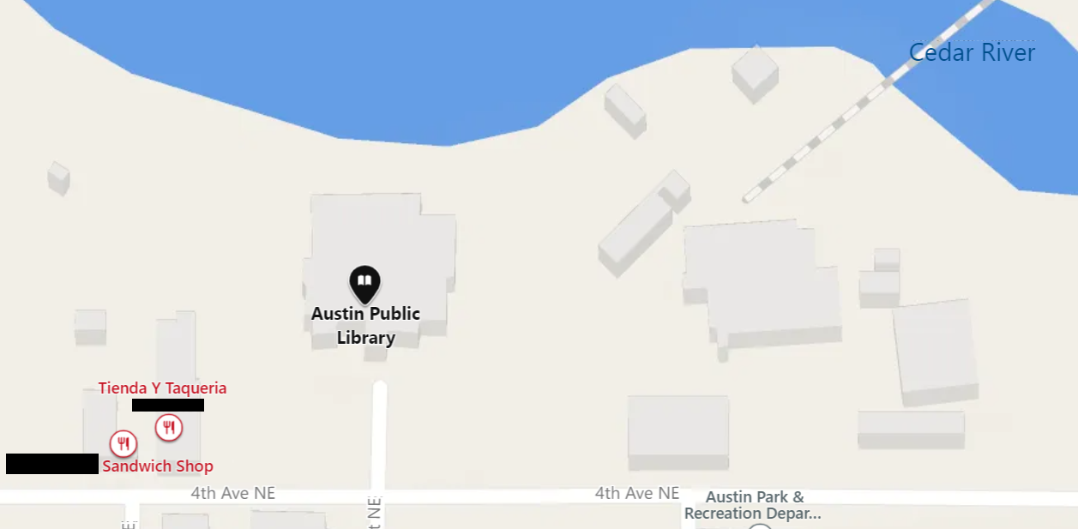
Safe House #6
of the I.M.P.R.E.S.S.
Type: GR

Slide 10
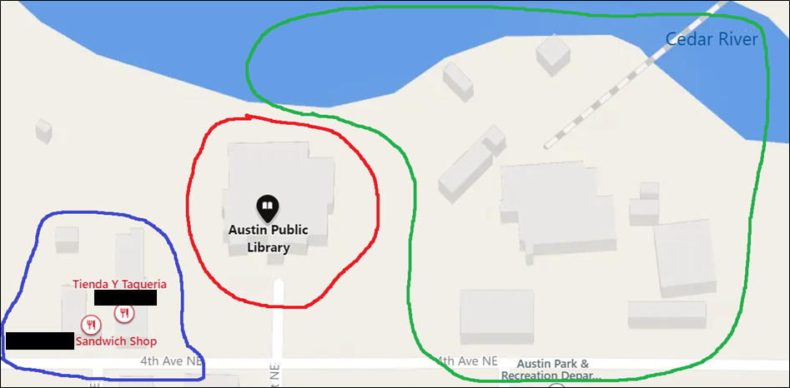
Safe House #6
of the I.M.P.R.E.S.S.
Address: 323 4th Ave NE, Austin, MN 55912
Type: GR
Zone 4-2
Pros:
*Fighters above average.
*Access to water vehicles.
*Safe area.
*Many resources.
Cons:
*Far away from other safe houses.
Emergency vehicle parking lot #1
Controlled Perimeter #3
Zone 6-2
Emergency vehicle parking lot #2
Zone 6-2
Controlled Perimeter #2
Meeting center and personnel barracks #2
Zone 6-5
Improvise refugee center
Zone 6-7
Armory
Zone 6-6
Cafeteria
Improvise infirmary #2
Zone 6-9
Zone 6-1
Improvise infirmary #1
Zone 6-1
Water filtration and backup generator
Zone 6-9
Controlled Perimeter #1

Slide 11
Safe House #7
of the I.M.P.R.E.S.S.
Address: 523 N 3rd St, Brainerd, MN 56401
Type: GR

Slide 12
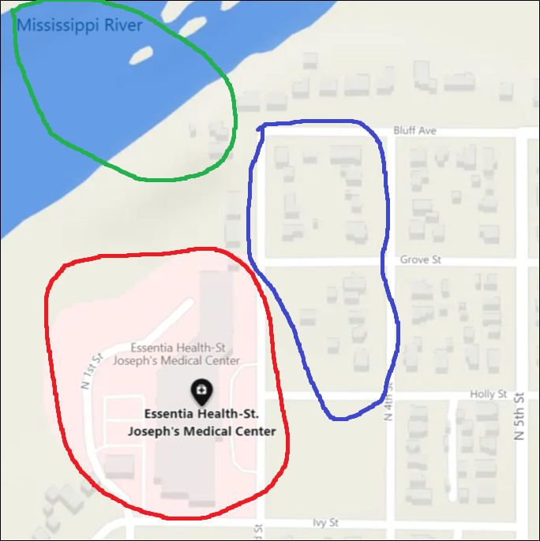
Training center
Zone 7-4
Safe House #7
of the I.M.P.R.E.S.S.
Address: 523 N 3rd St, Brainerd, MN 56401
Type: CR
Workshop for maintenance and construction of defenses
Zone 7-3
Controlled Perimeter #3
Pros:
*Superior room capacity.
*Superior infirmary.
*Medical personal above average.
*Superior consumable supplies.
*Access to water vehicles.
*
Cons:
*Many hostiles in the area.
*High value target.
Meeting center and personnel barracks
Improvise refugee center
Zone 7-5
Zone 7-7
Improvise infirmary
Zone 1=7-1
Water filtration center and backup generator
Armory
Zone 7-6
Controlled Perimeter #2
Controlled Perimeter #21
Zone 7-9

Slide 13

Pine Technical & Community College
Safe House #1
of the I.M.P.R.E.S.S.
Address: 900 4th St SE, Pine City, MN 55063
Type: CR

Slide 14
Pine Technical & Community College
Safe House #2
of the I.M.P.R.E.S.S.
Address: 900 4th St SE, Pine City, MN 55063
Type: CR
Pros:
*Serves as a stop point for other safe houses.
Cons:
*Multiple hostiles in the area.
*Too many refugees need relocation.
Controlled Perimeter #1
Meeting center and personnel barracks #1
Armory
Workshop for maintenance and construction of defenses
Zone 2-5
Zone 2-3
Zone 2-6
Controlled Perimeter #3
Training center
Cafeteria
Emergency vehicle parking lot
Zone 2-4
Zone 2-9
Zone 2-8
Improvise infirmary
Zone 2-1
Water filtration center and backup generator
Improvise refugee center
Zone 2-7
Controlled Perimeter #2
Zone 2-9

Slide 15
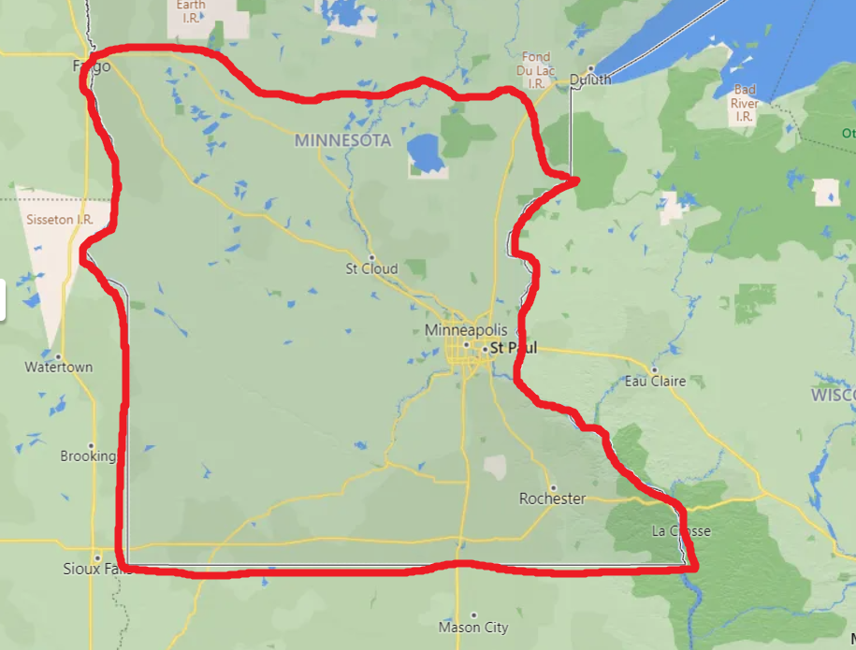

7
2
3
4
5
1
6

